Slide 1


Hospitality Analytics Project
Group 3
Kishore Kumar Agidi
Anju Vettathil
Shazmeen Fathima
P Vijay Kumar
shalu Sharma
Vishal Kanti Rajput
Ponnam Manisha

Slide 2
Introduction
Hospitality means the friendly and generous reception of guests, visitors, or strangers.
It involves providing comfort, care, and services in industries like hotels, restaurants, and tourism.
In business, hospitality focuses on creating positive guest experiences, improving satisfaction, and building long-term relationships.
mIt can refer to the personal act of a host welcoming someone to their home or, more broadly, to a commercial industry that provides services like food, drink, accommodation, and entertainment to paying customers

Slide 3
Project Overview
The Project focuses on analyzing the performance of “atliq hoispitality”, a leading hotel chain aiming to improve it’s occupancy rate , revenue and customer satisfaction. The client’s data was sacttered across multiple systems including booking,customer and property datasets which made it difficult to track performance and make data driven decisions.
As a Data Analyst, the goal was to design and build interactive dashboards using Excel,Tableau and Power BI to provide unified insights into the company’s operations.The dashboards help the management team monitor KPI’S, identify under-performing properties, and support strategic decisions such as pricing optimization and revenue forecasting.

Slide 4
Objectives
Understand and analyze hospitality industry data
develop an integrated analytical solution to track and monitor hotel performance metrics.
Build dashboards that provide insights into :
Revenue Performance
Occupancy Rates
Booking and cancellation trends
City and Property level performance
Identify patterns and KPIs for decision-making
Provide insights for improving occupancy and revenue
Develop recommendations for data-driven hospitality management

Slide 5
Tool’s Used
TOOL | PURPOSE
EXCEL | Data Cleaning,aggregation,KPI and dashboard creation
TABLEAU | interactive visualization for city wise and class wise analysis
POWER BI | advance analytics and DAX-based KPI calculations
SQL | Data extraction and transformation

Slide 6
Challenges
Difficulty cleaning and integrating data from multiple sources
Handling large datasets in Excel and SQL
Query errors and optimization issues in SQL
Designing visually appealing and interactive dashboards
Duplicate bookings, null values, and inconsistent formats (e.g., date/time or currency) lead to incorrect reports.
Large data volumes (e.g., years of bookings, transactions) slow down dashboards in Power BI/Tableau.
Some Dashboard look goods on desktop but break on mobile/tablets.

Slide 7
Solutions
Adopt proper data cleaning techniques before visualization
Use efficient SQL queries with joins and indexing
Standardize data formats across all tools
Design dashboards with clear KPIs and filters
Use tooltips, slicers, and filters in Power BI/Tableau for interactivity.
Include legends and data labels for clarity.
Leverage Power BI and Tableau for interactive reporting
Regular testing and validation of dashboards

Slide 8
KPI CARDS
The business achieved 1.71B in revenue with 134,590 bookings, maintaining a healthy utilization of 57.87% despite a 24.83% cancellation rate.”

Slide 9
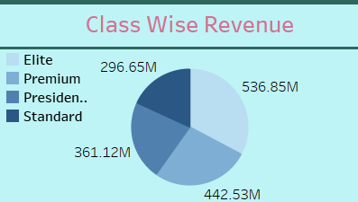
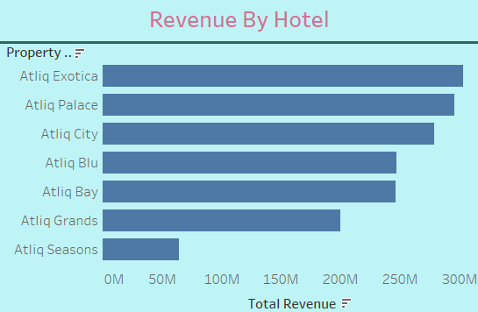
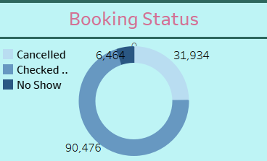
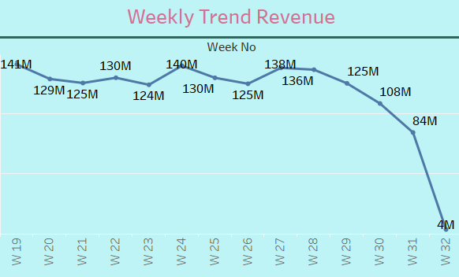
Visuals

Slide 10

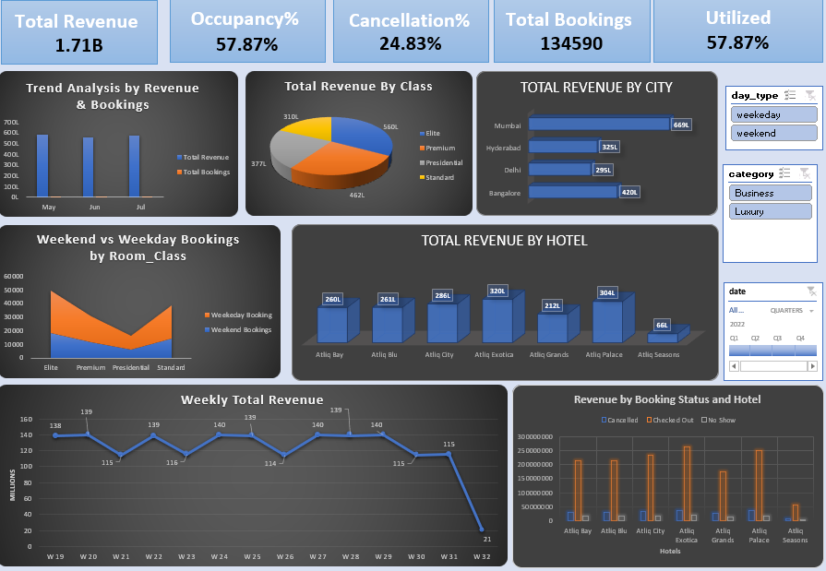
Excel Dashboard
Total Revenue: ₹1.71B | Occupancy: 57.87% | Cancellations: 24.83%
Top City: Mumbai (₹669L) | Lowest: Delhi (₹295L)
Top Hotels: Atliq Exotica & Atliq Palace | Lowest: Atliq Seasons
Elite & Premium rooms drive maximum revenue.
Weekday bookings higher than weekends → strong business segment.
Revenue peaked in Weeks 24 & 28; drop seen in Weeks 30–32.

Slide 11

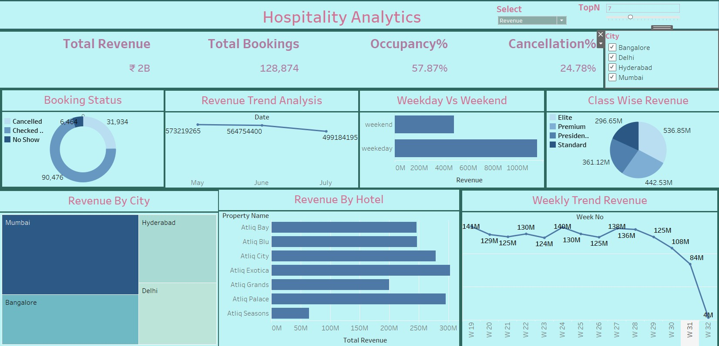
Tableau Dashboard
Total Revenue: ₹2B | Total Bookings: 128,874 Occupancy: 57.9% | Cancellations: 24.8%
Weekday bookings significantly higher than weekends → strong corporate demand.
Top City: Mumbai leads in total revenue, followed by Bangalore.
Top Hotels: Atliq Palace & Atliq Exotica show highest revenue.
Room Class Performance: Elite & Premium generate maximum revenue.
Weekly Trend: Revenue peaked in Week 19–26, then dropped sharply after Week 30.
Booking Status: ~70% checked-out, ~25% cancelled — indicates scope to reduce cancellations.

Slide 12

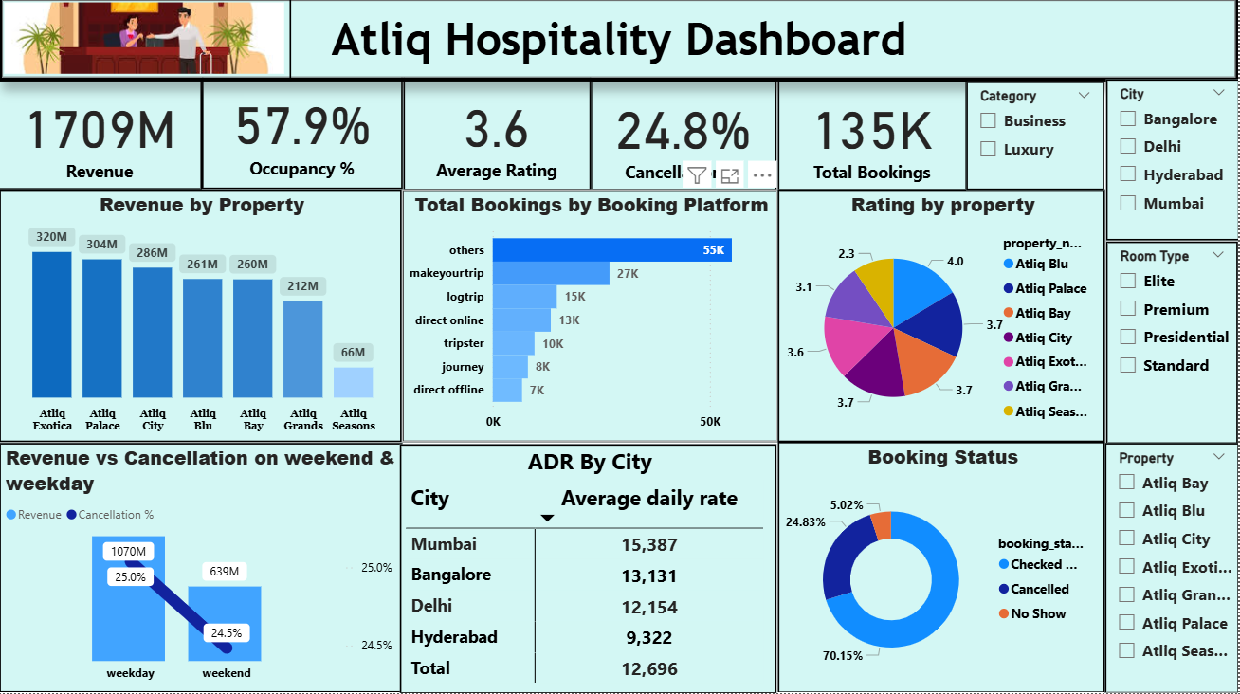
PowerBI Dashboard
Total Revenue: ₹1.71B | Occupancy: 57.9% | Avg Rating: 3.6
Cancellations: 24.8% | Total Bookings: 135K
Top Properties: Atliq Exotica (₹320M) & Atliq Palace (₹304M)
Lowest Performer: Atliq Seasons (₹66M)
Weekday Revenue (₹1070M) higher than weekend (₹639M) → strong business travel base.
Mumbai leads in ADR (₹15,387), followed by Bangalore (₹13,131).
Booking Platforms: Majorty“Others”&“Makeyourtrip”.
Customer Ratings: Highest for Atliq Blu (4.0), lowest for Atliq Seasons (2.3).
Booking Status: 70% checked-out, 25% cancelled, 5% no-show.

Slide 13
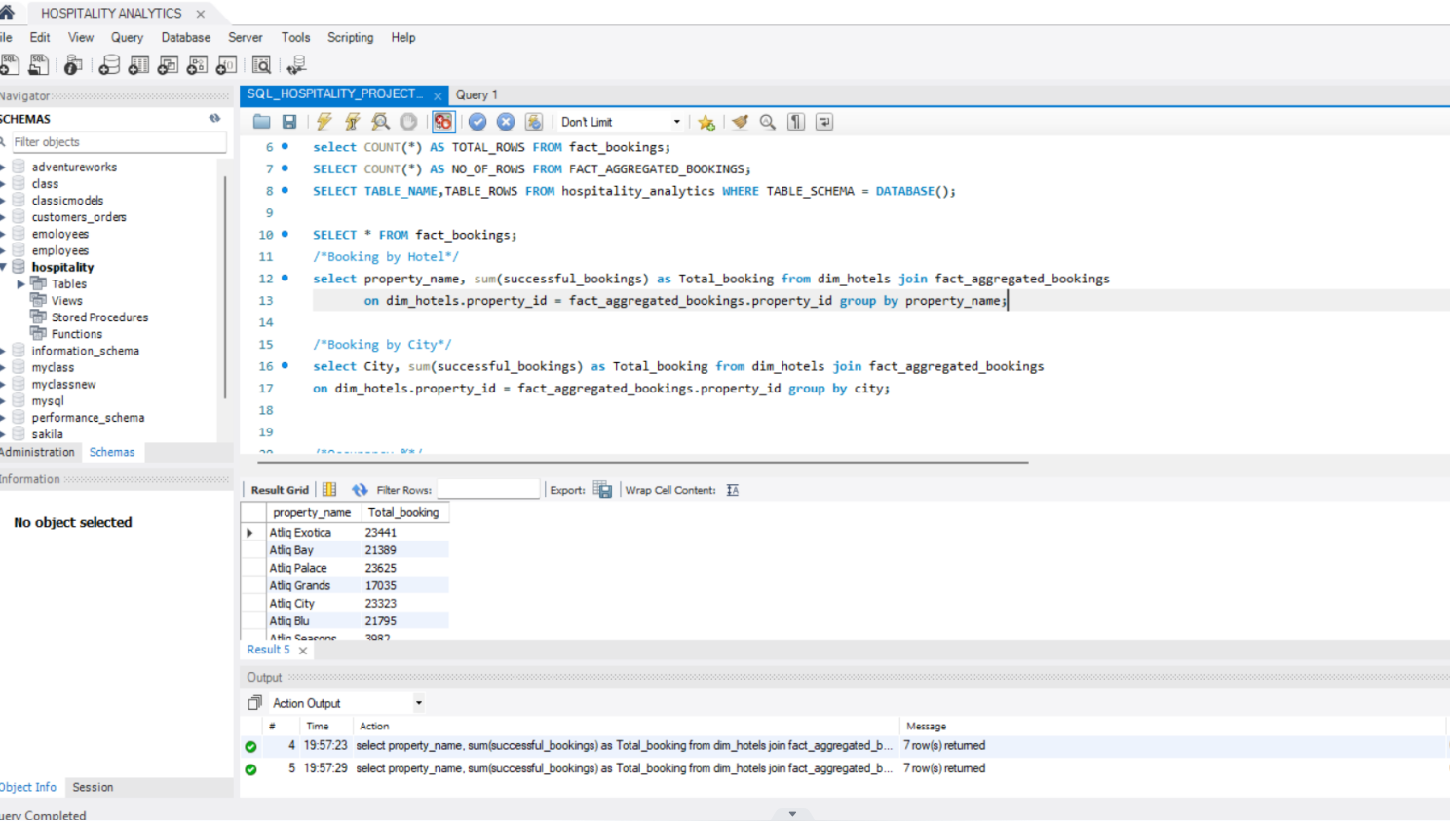
SQL Queries

Slide 14
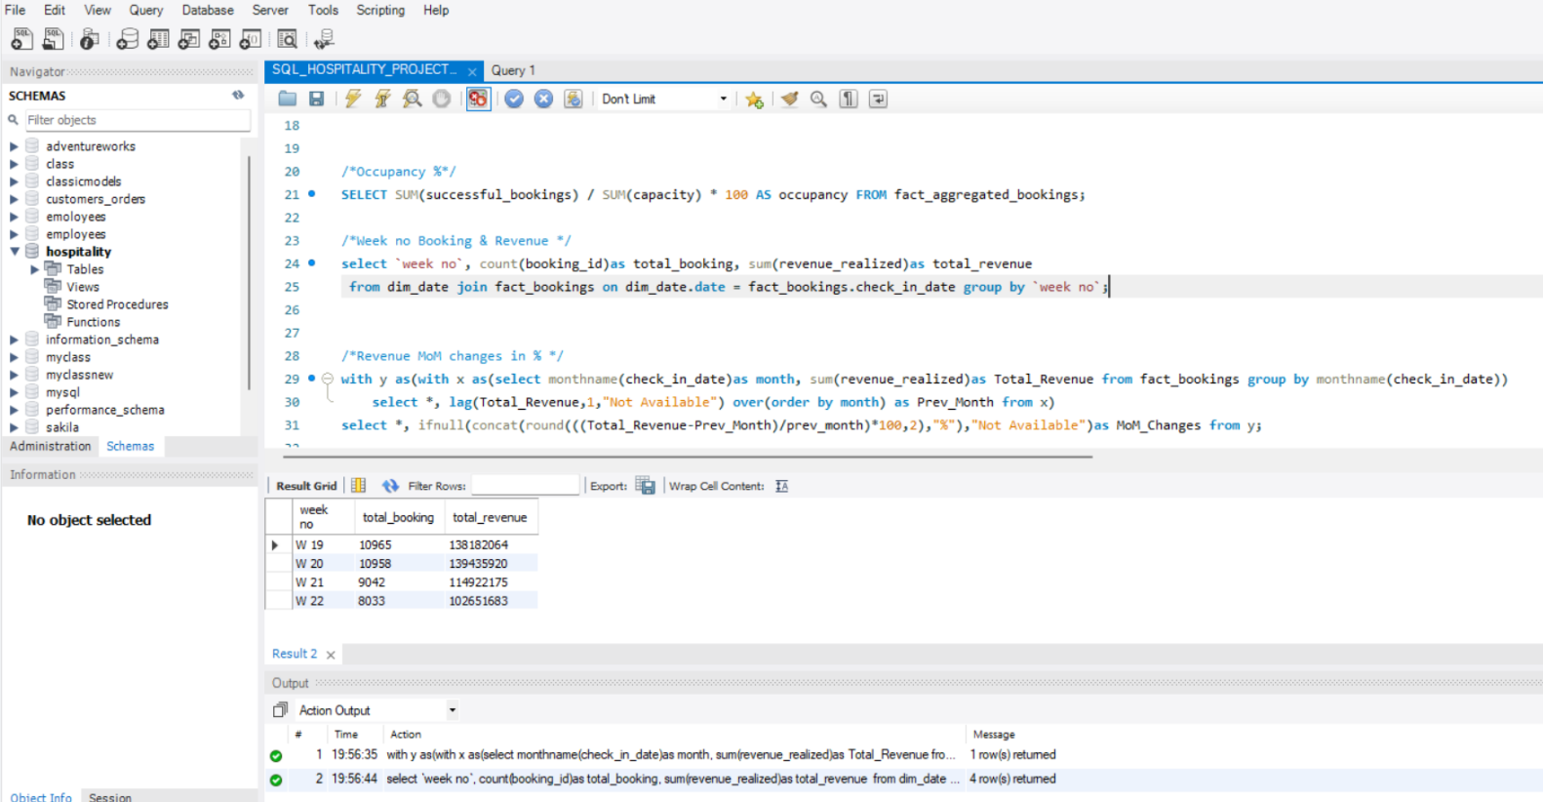
SQL Queries

Slide 15
INSIGHTS FROM THE PROJECT
1.City-Level Insights
Top Performing City: Mumbai — highest revenue (~₹669M) and highest Average Daily Rate (ADR ₹15,387).
Second: Bangalore — strong ADR (₹13,131).
Lowest Performing City: Delhi — lowest total revenue (~₹295M).
Mumbai and Bangalore are strong business hubs; Delhi might require marketing or pricing adjustments.
Revenue & Room InsighT
2. Elite & Premium Rooms: Drive maximum revenue.
Upselling premium rooms or improving mid-tier options could boost revenue further.
Revenue Distribution: Weekday revenue ₹1070M vs Weekend ₹639M — again confirming business focus.Booking Channel Insights
3. Major Booking Platforms: “MakeMyTrip” and “Others” dominate. Partnership analysis could identify most profitable channels and optimize commission rates.

Slide 16
Conclusion
The hospitality project has provided valuable insights into how data-driven tools like Power BI, Tableau, Excel, and MySQL can significantly enhance operational efficiency, guest satisfaction, and decision-making processes within the hospitality industry.
By designing and implementing interactive dashboards, we successfully integrated multiple data sources to track key performance indicators (KPIs) such as occupancy rates, revenue, customer feedback, and operational costs. This not only improved transparency and reporting accuracy but also empowered management to make informed, strategic decisions in real-time
In conclusion, this project reinforces that technology and data intelligence are essential for delivering exceptional guest experiences and achieving operational excellence in today’s hospitality landscape.

Slide 17
Thank you

